Slide 1
STC TV DATA ANALYSIS
Sahad Fawaz Aljahdali

Slide 2
Top 5
Programs
The Boss Baby
The Amazing pider-Man
The Expendables
Moana
Trolls
29%
19%
17%
16%
19%
This graph summarizes the most popular movies based on their total watch time in hours.

Slide 3
UNDERSTANDING USER BEHAVIOR
71%
Total duration spent by program class.
Users spend more time engaged with individual episodes of a series, leading to a higher total watch time for SERIES/EPISODES.
29%
SERIES/EPISODES
MOVIE

Slide 4
UNDERSTANDING USER BEHAVIOR
74%
Total Users watching by program class
Movies attracting a wider audience with shorter individual viewing sessions compared to series episodes. .
26%
SERIES/EPISODES
MOVIE

Slide 5
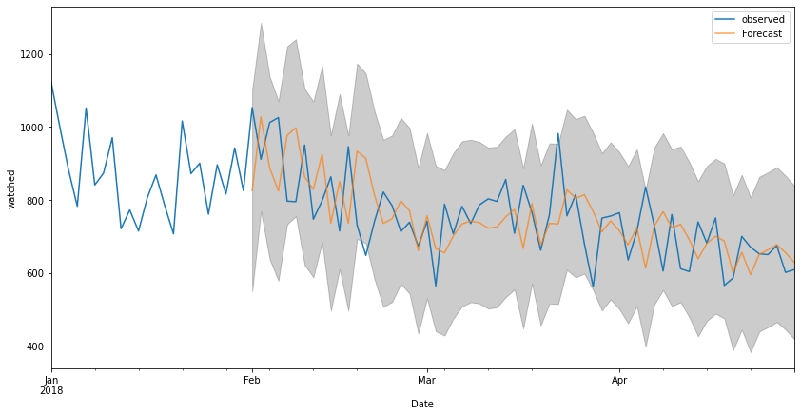
BUILDING A MODEL TO PREDICT USER BEHAVIOR
It may be due to the user experience: Therefore, I suggest gathering user feedback through a questionnaire.
Observed decrease in user watch time and the anticipated future decline.

Slide 6
PROVIDING RECOMMENDATIONS USING MACHINE LEARNING ALGORITHMS
Using machine learning algorithms, I have generated five recommendations for viewers of the movie "Moana". These recommendations are based on user preferences and viewing patterns, aiming to enhance the overall experience. By leveraging advanced algorithms, we can provide personalized suggestions that align with individual tastes and interests, increasing the likelihood of viewer satisfaction.
1: Trolls 2: Surf’s Up 3: The Mermaid Princess 4: The Boss Baby 5: The Jetsons & WWE: Robo-WrestleMania!

